Slide 1

Mass Assignment/Overposting in ASP.NET MVC
By: Ahmed Al-asaad

Slide 2
About me
Specialized in Identity and Access Management, DevOps practices, software architecture, team leadership, development, code audit, and performance and load testing
Azure, MIM , TFS, BizTalk, WPF, WinForms, ASP.NET Silverlight, SQL Server)
Website: www.lajak.com
Consultant since 2010
Microsoft MVP (ALM) since April 2013

Slide 3
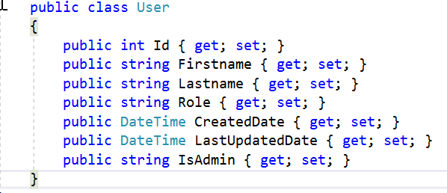
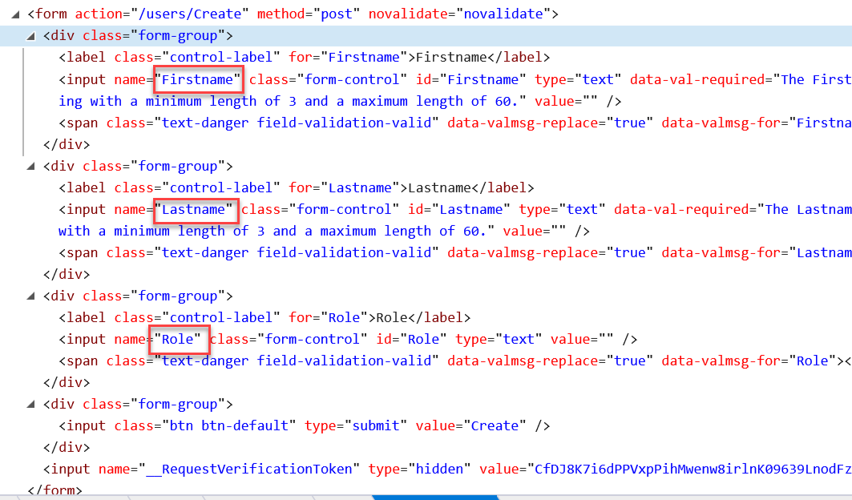
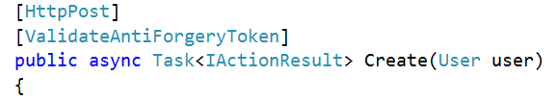
ASP.NET MVC concepts
View
Model
Controller: Action method

Slide 4
How binder workers
View
Model
Controller: Binder uses reflection

Slide 5
Overposting – cont’d
With tools like Burp, extra fields can be injected and passed to the action method

Slide 6
Solution
Never expose your database entity in an Action Method
Use ViewModels
Always grab the fields that the user is authorized to change

Slide 7
Demo

Slide 8
Questions

